Slide 1


UWLA and The Unified Water Label

Slide 2
The UWLA is a:
Legal body that hosts the Unified Water Label - UWL
Voluntary industry initiative to label water using bathroom products across Europe

Slide 3
The UWLA is:
Run by an elected board of directors, with a general assembly that sets and manages the direction of the scheme
Operated under a transparent system, with all documents available for brands to view. Rules and regulations allow for all registered brands to have equal voting rights
Open to all companies selling a relevant product that meets the Scheme criteria on the EU, EFTA and EEA markets

Slide 4
The UWL is:
A voluntary, industry led scheme, which is simple, clear, concise and a cohesive message to make an informed choice
Supported by over 160 brands that represents around 70% of the European and 80% of the UK bathroom industry
Fully accepted and formally recognised within the newly published ISO 31600 Water Label Standard
Facilitating organic market transformation and supporting circular economy goals

Slide 5
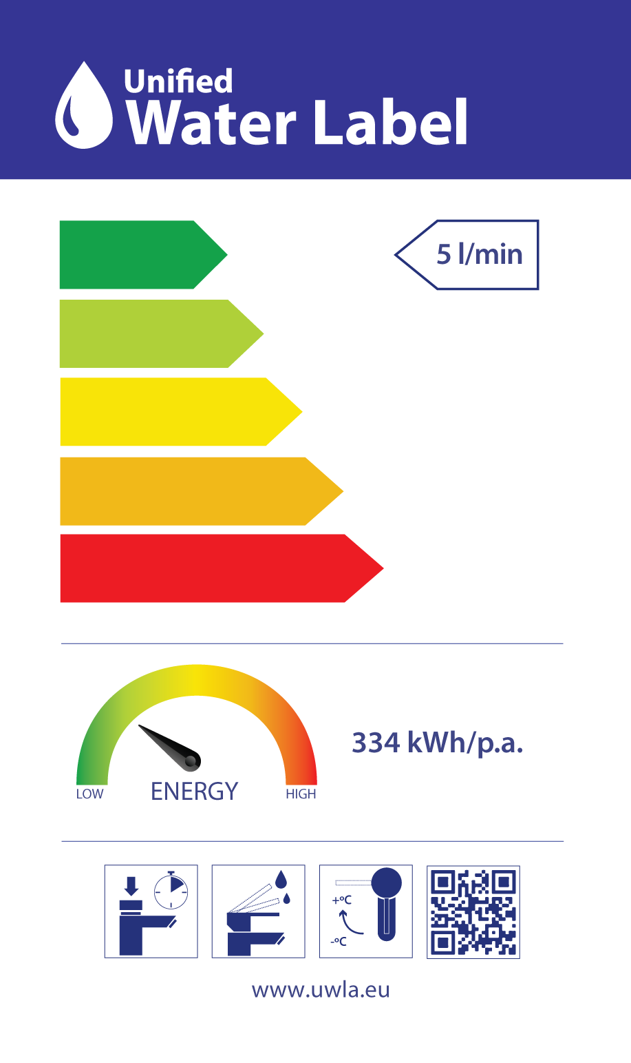

Slide 6
The UWL:
Sits alongside schemes such as WELS (mandatory Australian scheme) and Watersense (USA voluntary scheme)
Is also recognised as the scheme for Egypt
ISO 31600 recognised globally

Slide 7
The UWL covers:
Showers
Taps
WC’s Urinals (including bowls, independent flushing cisterns, controllers and flush free)
Baths
Recirculating showers
Spray WCs and seats is under production

Slide 8
In 2022 the UWL will have grown to include:
160 brands
16 supporters promoting the scheme across all countries
15,180 current live product registrations – growing every day

Slide 9
 |  | Product Registrations | Company Registrations
2008 |  | 800 | 18
2009 |  | 1069 | 22
2010 |  | 1288 | 23
2011 |  | 1904 | 29
2012 |  | 2343 | 39
2013 |  | 3600 | 50
2014 |  | 7350 | 73
2015 |  | 8300 | 89
2016 |  | 9750 | 120
2017 |  | 10900 | 132
2018 |  | 11000 | 143
2019 |  | 11864 | 149
2022 |  | 14041 | 155
2023 |  | 15,180 | 160
Products removed |  | 6845
Company’s removed |  |  | 11
Cleansing of scheme annually to ensure its fresh and only contains products available in the market are visible on the database
Progress – Scheme Growth since 2008

Slide 10
Our aims and objectives are for:
More water using bathroom products that deliver on performance whilst providing consumers with sustainable products
Companies to make use of informative literature to promote the UWL, and gain a competitive advantage
All businesses involved in specifying, installing or selling water using products to promote UWL products to their customers
Governments pointing to UWL in Directives

Slide 11
Organic market transformation already taking place aligning with circular economy goals

Slide 12
Why:
Water scarcity is real and life depends on water
The bathroom industry has an important role to lead on the promotion of water and energy efficient products

Slide 13
UWLA activities are focussed on:
Improving visibility
Raising awareness
Increasing registrations
Influencing government decisions

Slide 14
UWLA offers a full suite of marketing material that includes:
Fact sheets
Posters
Flyers
Point of sale for products
Social media posts
Material for schools – education starts from grass roots

Slide 15
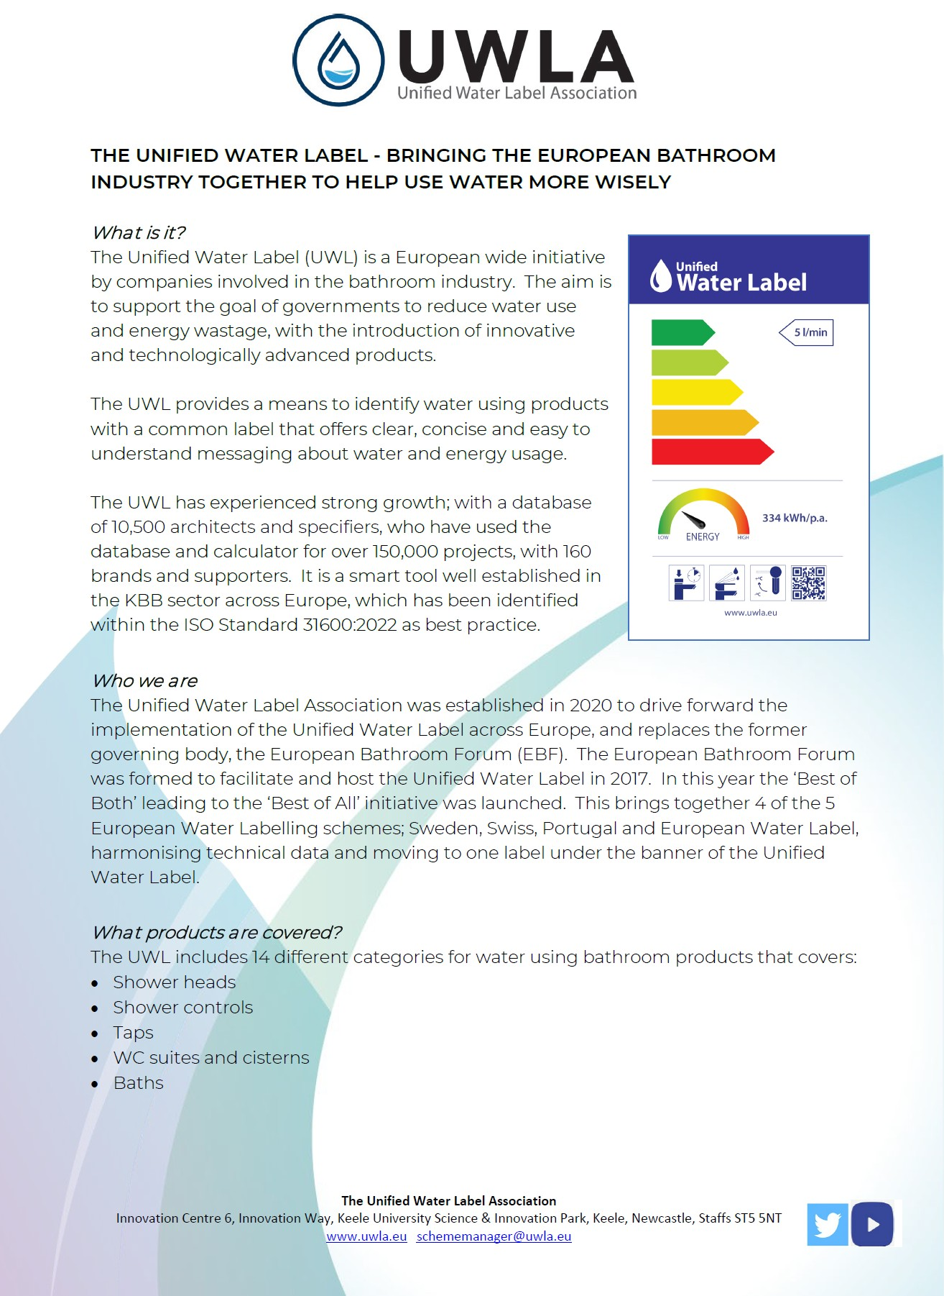
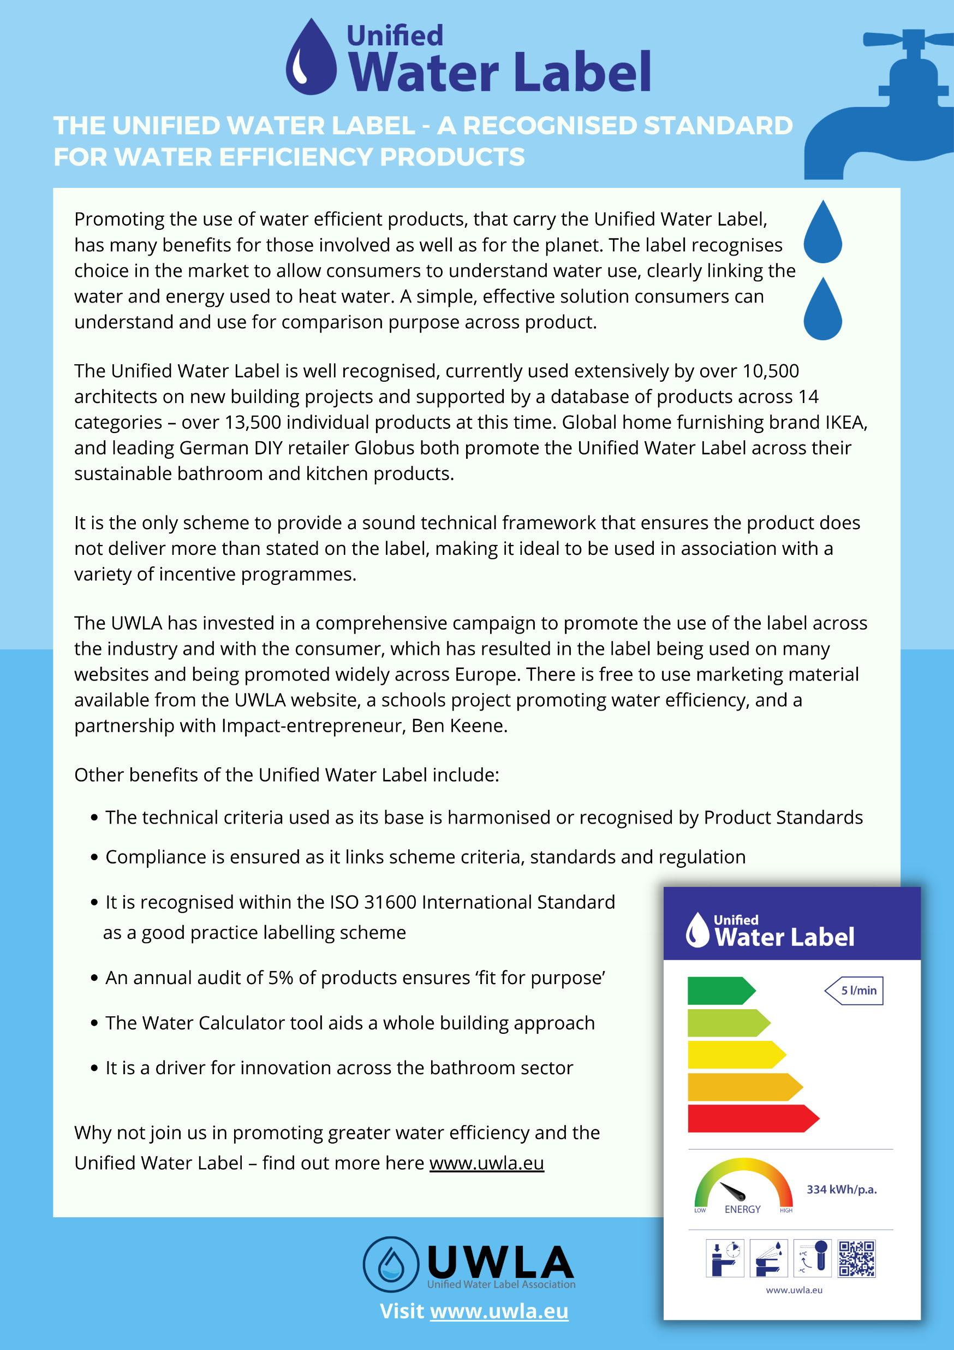

Slide 16
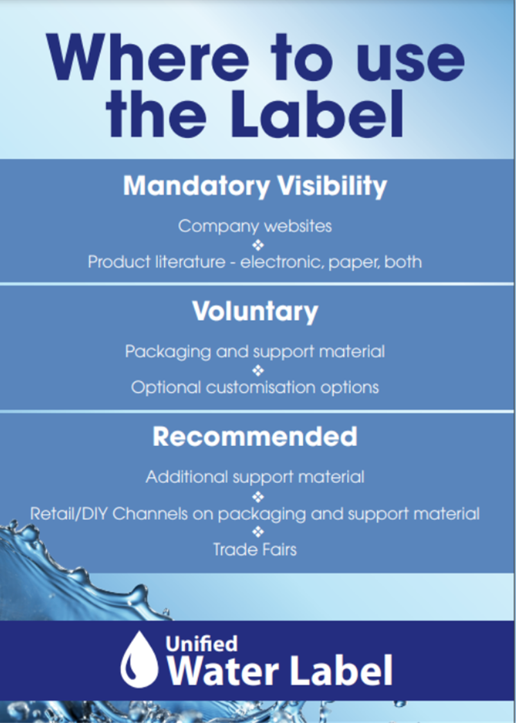
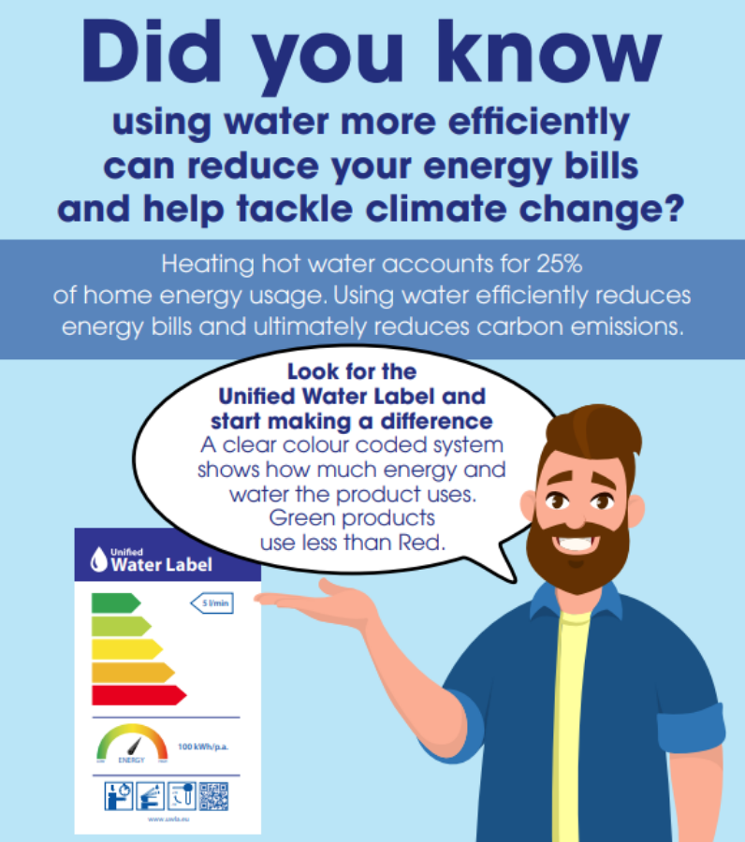

Slide 17
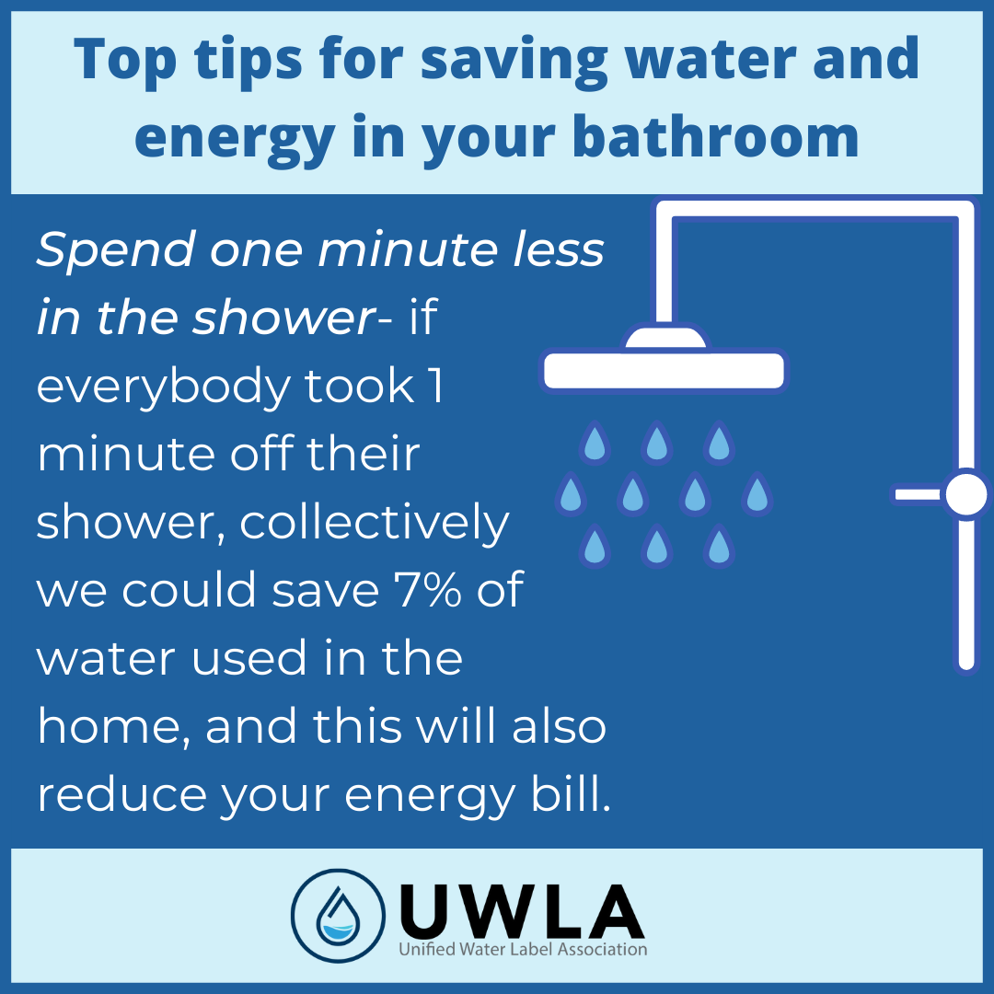


Slide 18
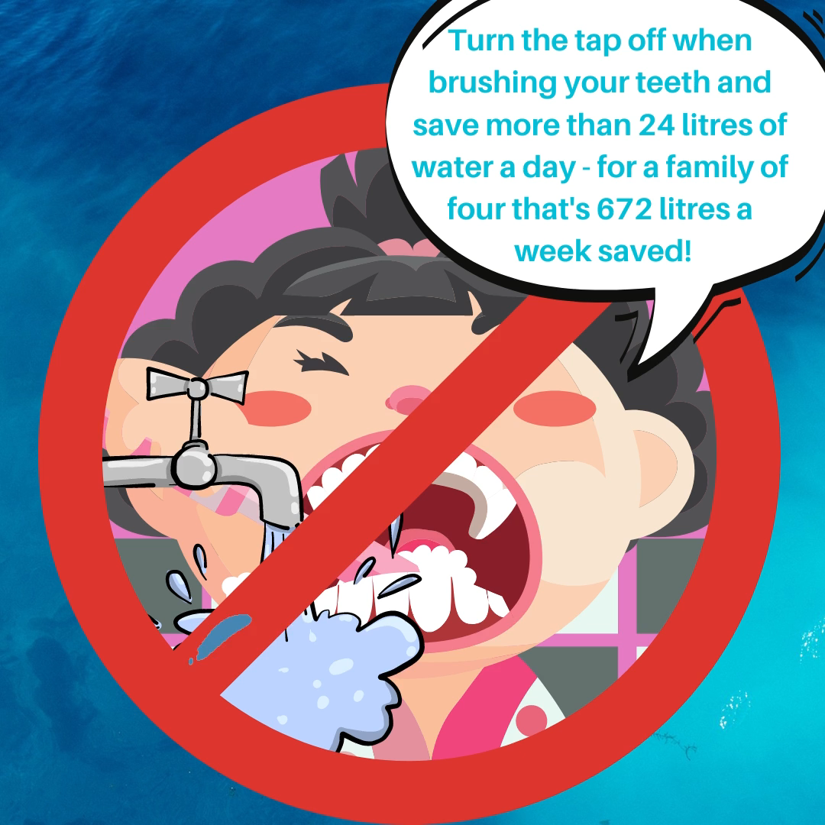

Slide 19
UWLA reaches out beyond the bathroom industry to include:

Slide 20
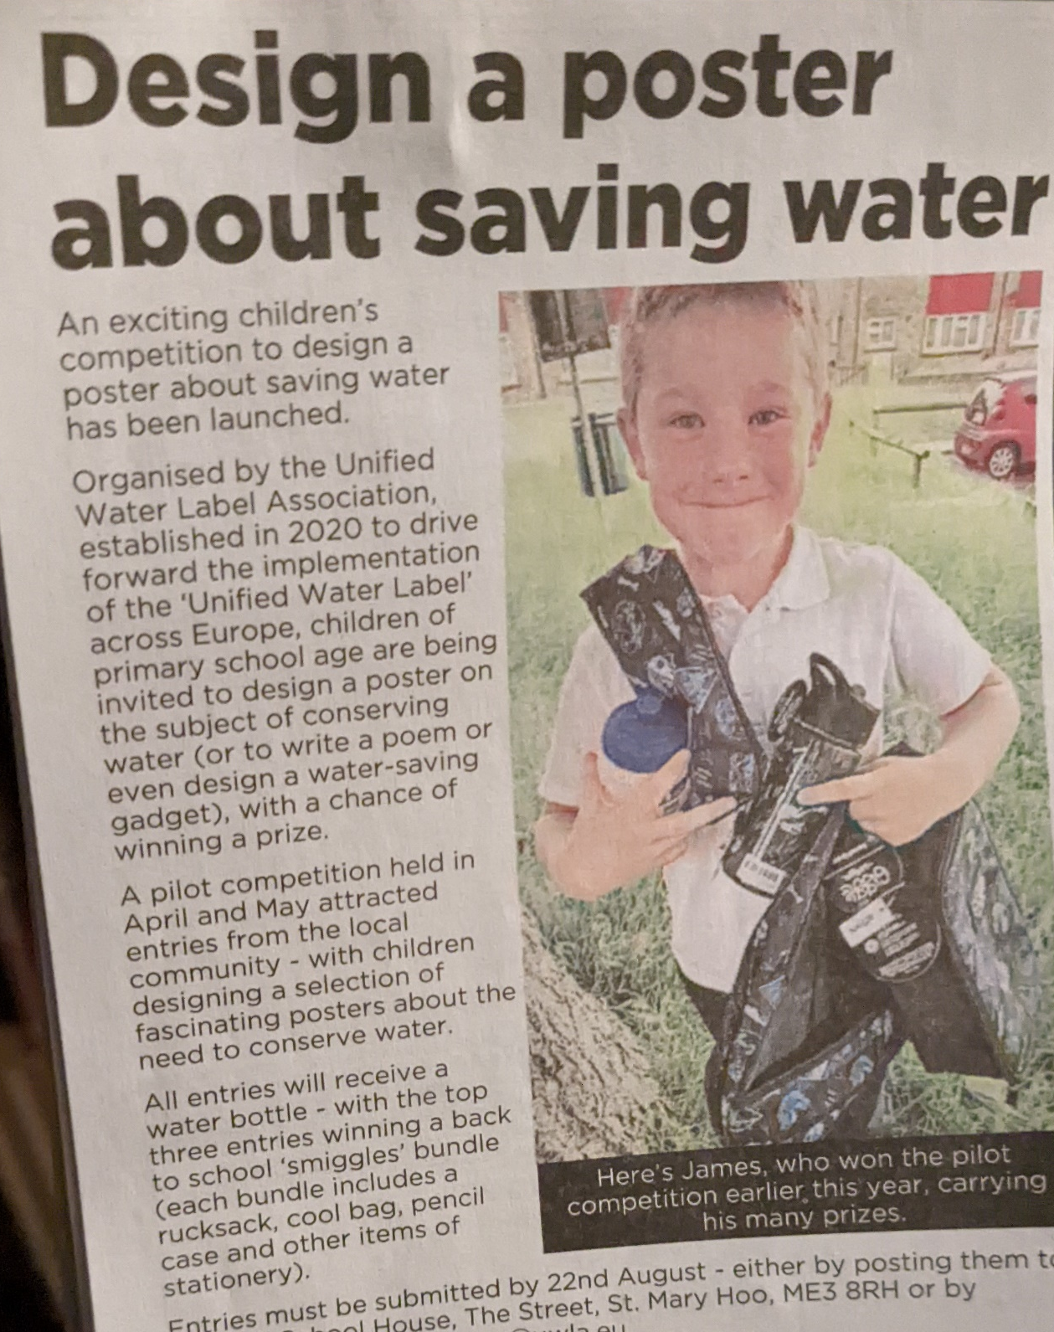
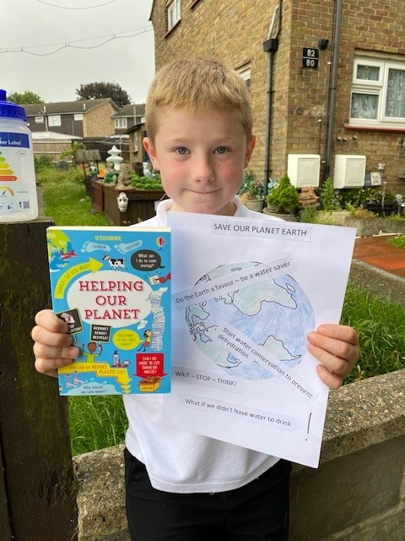
Work in primary schools to encourage children to learn about environmental issues and to think about the consequences of their choices and behaviours.
The schools packs help young people to understand the need to use water wisely and the link between water and energy efficiency.

Slide 21
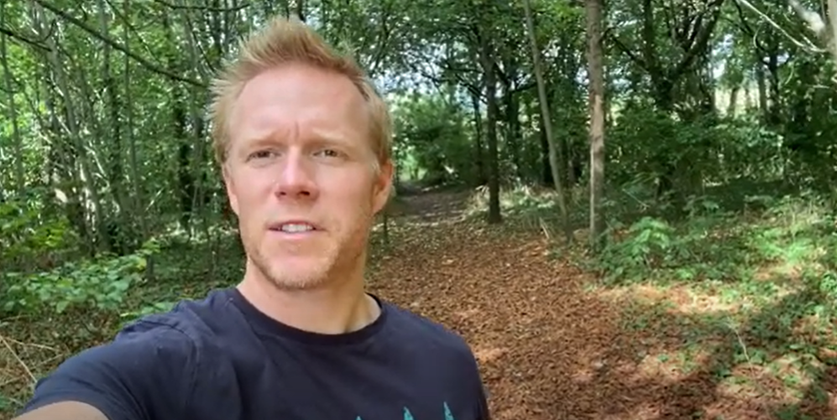
Ben Keene global environmentalist champions the UWL

Slide 22
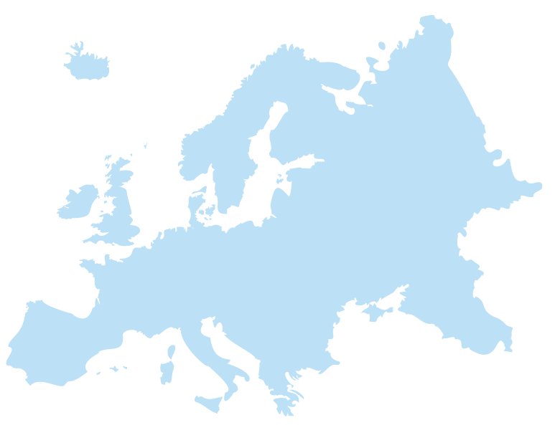
The UWLA is supported by Trade Association partnerships across Europe that includes:
AGRIVAL Spain
AVR Italy
Assobagno Italy
Ceramica Confindustria Italy
Pomsad Turkey
Keramverband Germany
IGBC Ireland
BMA UK
Anqip Portugal
All welcome

Slide 23
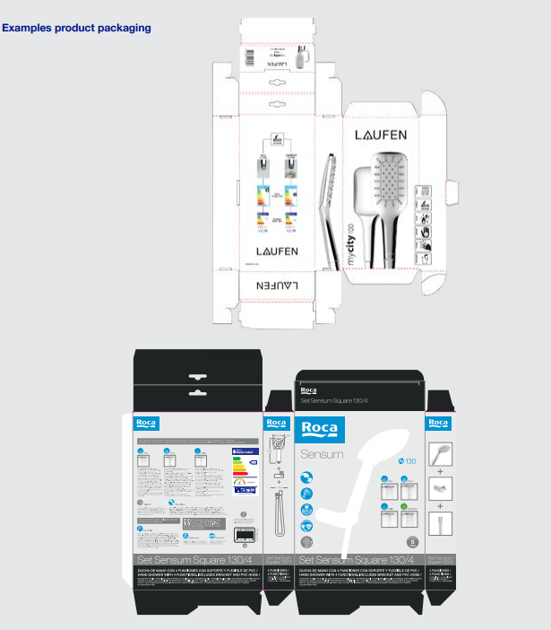
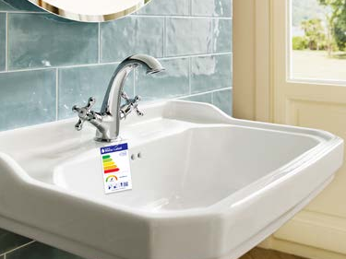
Visibility of the Scheme
The Scheme continues to grow with higher visibility in or on:
Retail stores
Packaging
Websites
Brochures
Fact sheets

Slide 24
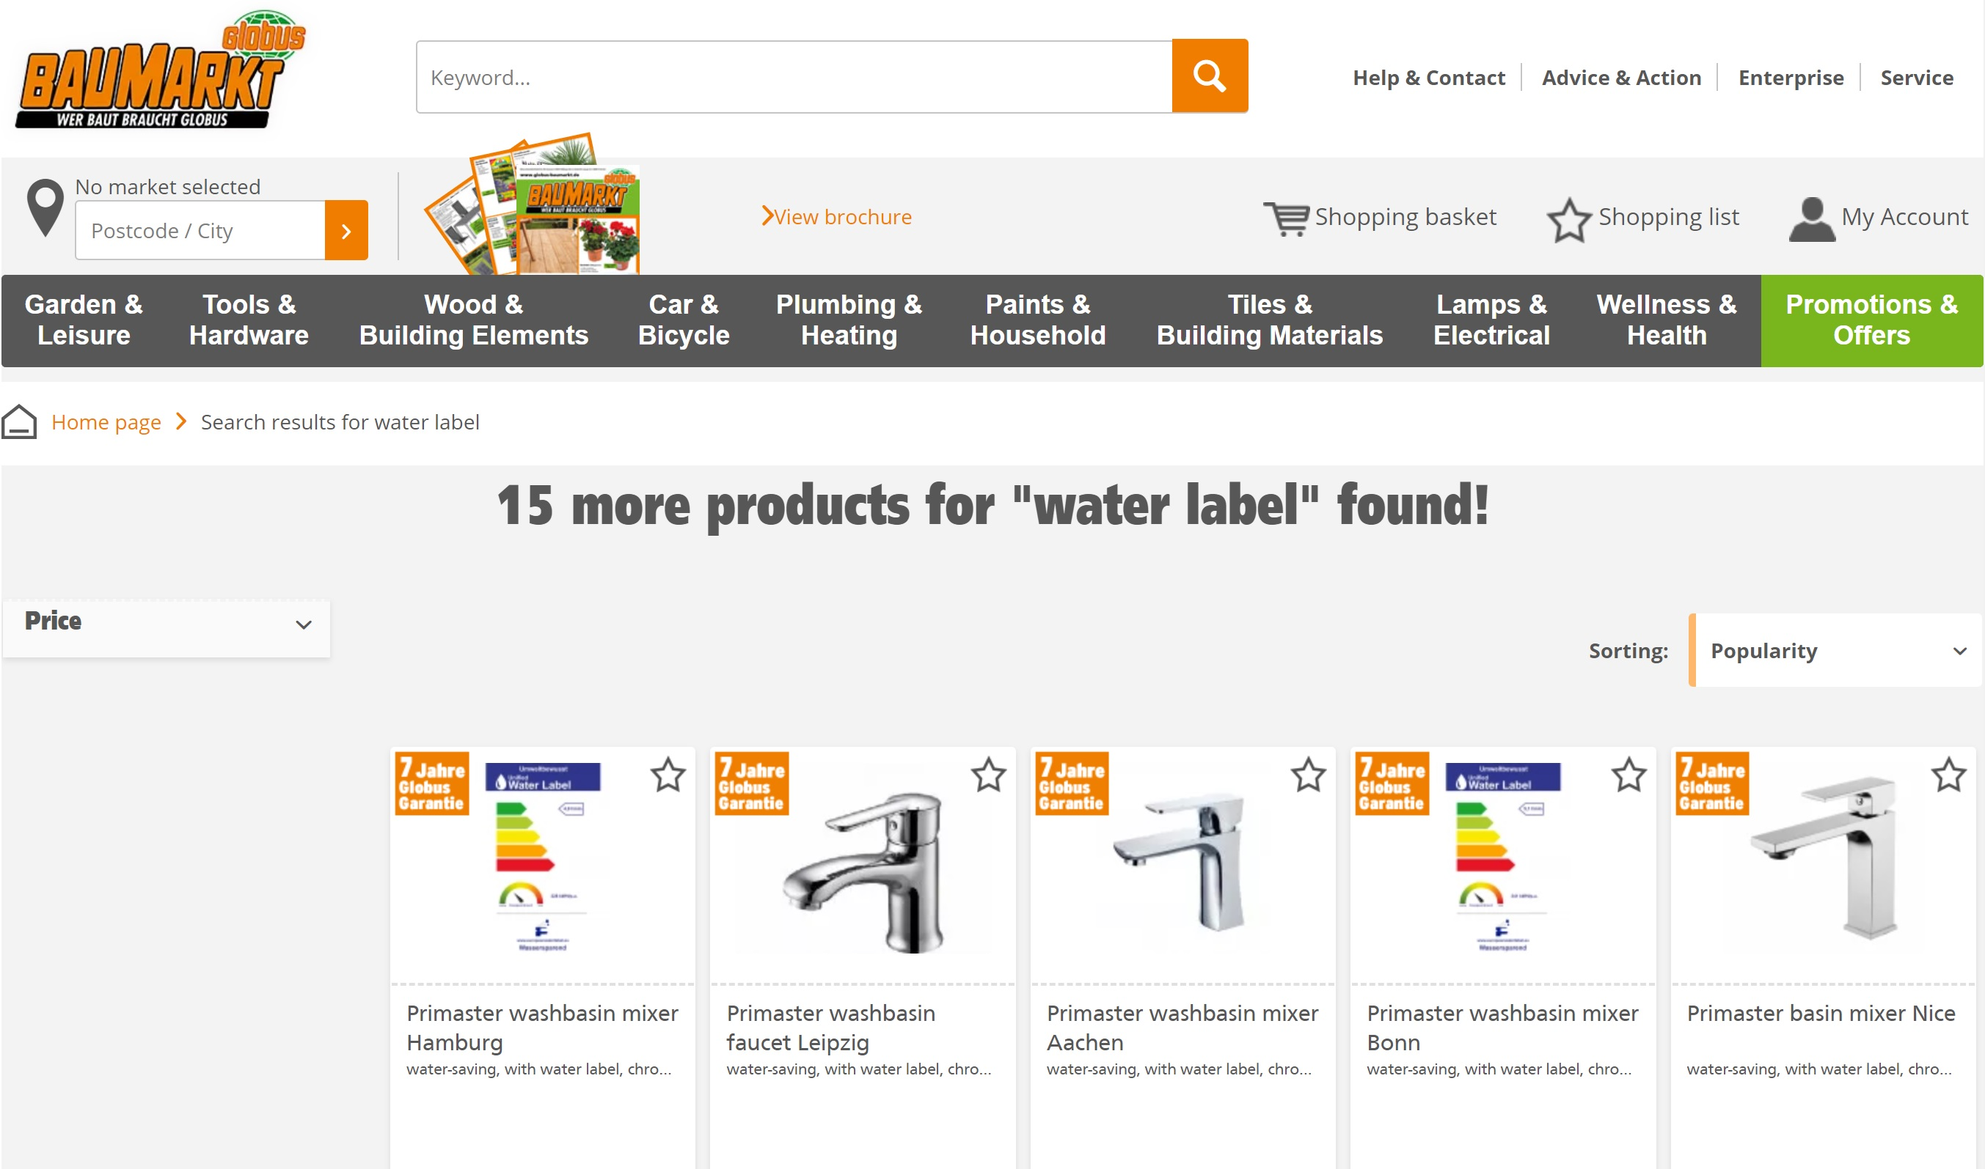

Slide 25
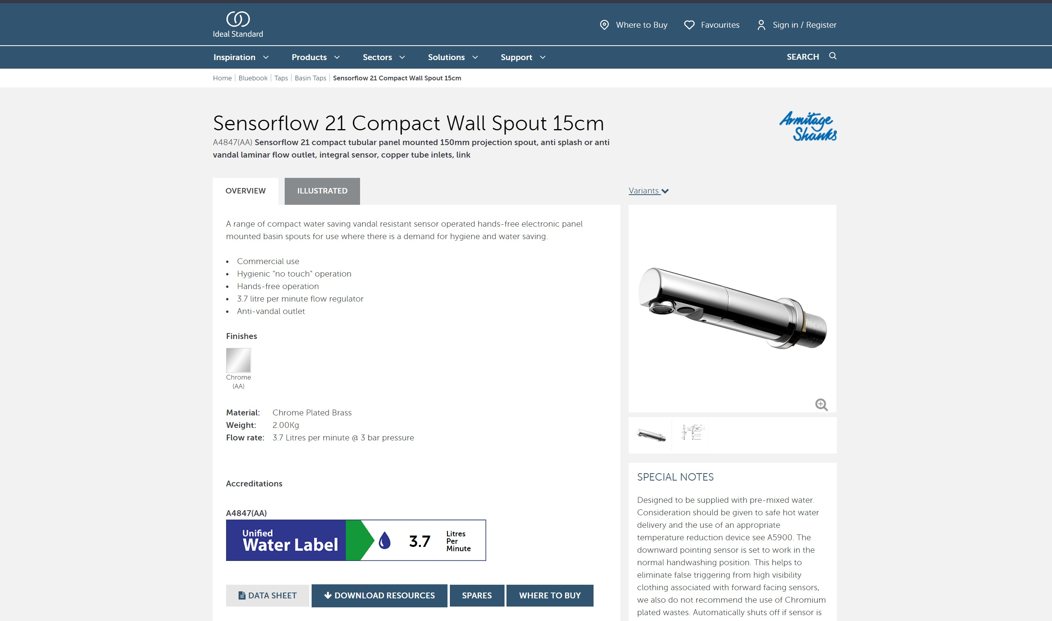

Slide 26
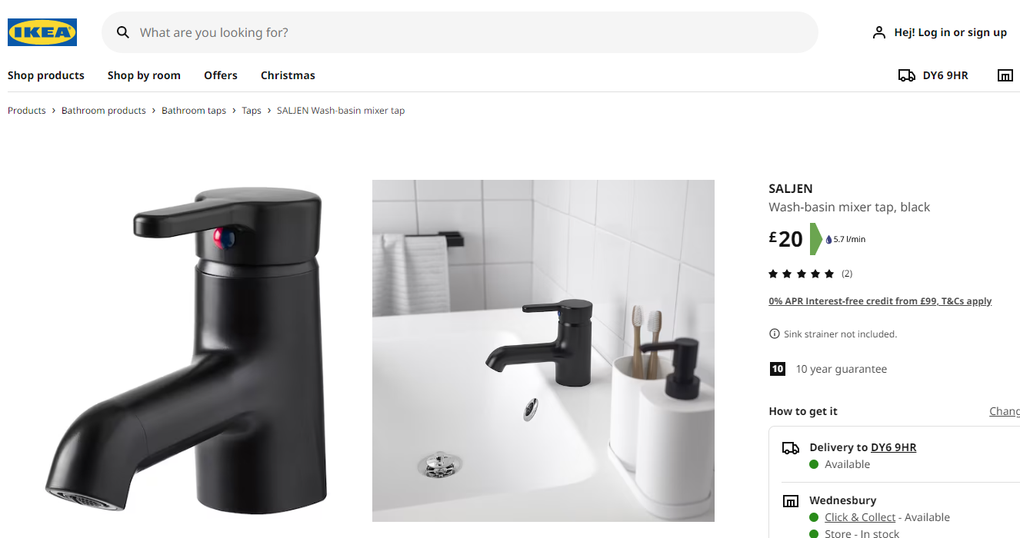

Slide 27
Buying Groups and Merchant Groups are also joining the Scheme and encouraging their suppliers to register OEM and branded products.
From 1 January 2023 tendering platforms will require Unified Water Label registrations, another initiative that demonstrates the Industry scheme is influencing.

